Slide 1


ACT-Based Treatment of Anxiety Disorders via Videoconferencing
James D. Herbert¹
Marina Gershkovich¹
Erica K. Yuen²
Elizabeth M. Goetter³
Evan M. Forman¹
¹Drexel University
²University of Tampa
³Massachusetts General Hospital
ACBS, Minneapolis
June 19, 2014

Slide 2

Current Landscape of Behavioral Treatment of Anxiety Disorders
Highly effective treatments
Accessibility continues to be a problem

Slide 3
Several million Americans with anxiety disorders do not have access to a therapist
50 million
people live in
non-metropolitan areas of the US

Slide 4
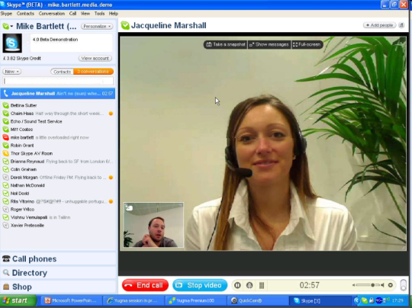
Bridging the Gap?
Videoconference-mediated treatments show promise
  Real-time video/audio communication
  Reduce logistical barriers (e.g., distance, time)
  May increase willingness to engage in tx
But…
  Research is preliminary
    Many VC technologies can be expensive (e.g. VA)
  Dedicated broadband vs. low-tech options
  Exposure-based treatments for anxiety can be difficult

Slide 5

Exposure-Based Procedures
Key component across various models of CBT
ACT model well suited to EXP tx
How well can in-session exposures be accomplished via videoconferencing?

Slide 6
Study 1: VC Treatment of SAD
Yuen, E. K., Herbert, J. D., Forman, E. M., Goetter, E. M., Juarascio, A. S., Rabin, S., Goodwin, C., & Bouchard, S. (2013). Acceptance based behavior therapy for social anxiety disorder through videoconferencing. Journal of Anxiety Disorders, 27, 389-397.
ACT

Slide 7

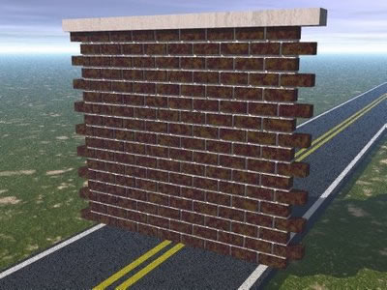
Social Anxiety Disorder (SAD)
Excessive fears of being
embarrassed and negatively
evaluated by other people
Most individuals with SAD do not receive treatment
  Fear of social interactions
  Geographic location
  Transportation limitations
  Stigma

Slide 8
Procedures
Online advertisements and clinic referrals
Telephone screen
Structured clinical interview
Skype lesson / test call
Baseline self-report questionnaires
1 month waiting period
Pre-treatment self-report questions

Slide 9
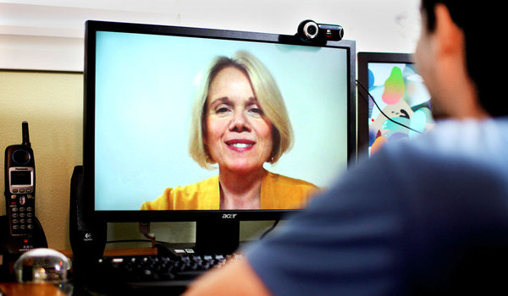
Treatment
12 one-hour sessions of weekly therapy in Skype
Manualized treatment protocol, combining simulated exposures (Heimberg, Clark) within an ACT framework (Herbert, Forman & Dalrymple, 2009).
Sessions 1-2: Psychoeducation
Sessions 3-12: In-session exposures, e.g.:
  Deliver speech to audience
  Ask person on date
  Ask for raise
Social skills training PRN
ACT concepts (willingness, acceptance, values, mindfulness, defusion) integrated throughout
Homework

Slide 10
Participants
  N = 24 adults in the US, dx generalized SAD via SCID-IV
  Age: 19 to 63 (M=35; SD=10.8)
  Gender: 75% male
  Ethnicity: 75% Caucasian, 8% Asian, 4% Black or African American, 4% Hispanic/Latino, 4% Other
  Prior Skype experience: 54% had prior Skype experience

Slide 11
Results: Feasibility/Acceptability
Dropout: 17%

Slide 12
Results: Feasibility/Acceptability

Slide 13
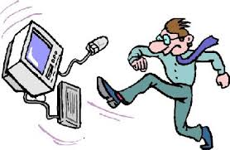
Feasibility/Acceptability
3% 2%

Slide 14
Feasibility/Acceptability
Technical Difficulty | % of Sessions
Sound quality (e.g., choppy, soft, echoing, delay) | 30%
Video quality (e.g., choppy, blurry, freezing, delayed) | 27%
Dropped or frozen video call | 6%
Unable to see video | 5%
Unable to hear sound | 3%
Technical difficulties not associated with treatment outcome: SPAI (r=-.04, p=.85), LSAS-Total (r=.12, p=.58), Brief-FNE (r=.18, p=.39)

Slide 15
Results: Feasibility/Acceptability
1%
Early sessions (first 10%) had greater technical difficulties,
X² (1, N = 263) = 3.39, p =.065.

Slide 16


Results: Feasibility/Acceptability
Convenience
  "It was convenient as I was able to meet with my therapist whether I was at home or on the road.”
  "I am a full time mother, so getting to stay in the comfort of my own home was extremely beneficial."

Slide 17

Results: Feasibility/Acceptability
Ease of communication
  “With the exception of one week where we had connectivity issues, it was fairly easy to communicate through Skype. I feel like it was just as effective as meeting in person would have been.”
  "Somewhat awkward at first, but it felt more natural before long."

Slide 18


Results: Feasibility/Acceptability
Technical Difficulties
  "Very easy to connect, video and voice quality were usually great.”
  "Sometimes I had some connection issues."

Slide 19
Results: Treatment Outcome
 | Pre-tx Mean | Post-tx Mean | 3-month FU mean | F | p | Effect size (Cohen’s d)
SPAI-SP | 138.57 | 89.07 | 84.06 | 19.59 | <.01 | 2.10
LSAS-Fear | 42.17 | 27.92 | 27.79 | 17.81 | <.01 | 1.35
LSAS-Avoidance | 38.25 | 19.79 | 22.33 | 14.25 | <.01 | 1.20
Brief-FNE | 50.21 | 39.13 | 37.50 | 16.27 | <.01 | 1.41
BDI | 15.92 | 6.13 | 5.63 | 6.77 | <.01 | 0.91
SDS-Total | 21.71 | 9.38 | 9.21 | 14.76 | <.01 | 2.35
QOLI | -0.09 | 0.96 | 0.99 | 3.02 | .05 | 0.55
AAQ-II | 29.50 | 23.42 | 20.13 | 7.26 | <.01 | 0.87

Slide 20
Results: Treatment Outcome

Slide 21
Results: Treatment Outcome

Slide 22
Results: Treatment Outcome
Pre-tx to FU Effect Sizes:
Skype: d = 2.10
In-Person: d = 1.41

Slide 23
Okay, so this seems to work for SAD. What about a real challenge, like OCD?

Slide 24
Study 2: VC treatment of OCD
Goetter, E. M., Herbert, J. D., Forman, E. M., Yuen, E. K., & Thomas, J. G. (2014). An open trial of videoconference-mediated exposure and ritual prevention for obsessive-compulsive disorder. Journal of Anxiety Disorders, 28(5), 460-462.
Goetter, E. M., Herbert, J. D., Forman, E. M., Yuen, E. K., Gershkovich, M., Glassman, L. H., Rabin, S., & Goldstein, S. P. (2013). Delivering exposure and response prevention for Obsessive Compulsive Disorder via videoconference: Clinical considerations and recommendations. Journal of Obsessive-Compulsive and Related Disorders, 2(2), 137-143.

Slide 25

Challenges of ERP for OCD
Heterogeneity of OCD
Complexity of OCD
  Covert compulsions
  Subtle avoidance behaviors
Therapist (usually) must be very active, hands-on

Slide 26
Participants
Inclusion:
  Adults with OCD
  Living in eligible state
  YBOCS ≥ 16
  Access to Skype via computer and broadband connection
  English fluency
Exclusion:
  Comorbid psychotic disorder
  Hoarding subtype
  Acute suicide potential
  Seeking additional therapy for OCD
  Not on a stable medication regimen for prior 3 months

Slide 27
Participants
N = 15 adults
87% female
Age= M=30.2
47% had a college degree
47% employed full-time
67% lived in nonmetropolitan areas,
40% lived >45 mins away from a specialist
47% familiar with Skype
67% had been in therapy before

Slide 28
Protocol
16-18, 90-min, twice weekly sessions
Starting in session 3, 60 mins of therapist-guided exposure
Exposure and ritual monitoring homework every session
Phone check-ins between sessions
Assessments at pre-, mid-, post-, and 3-month follow up

Slide 29
Feasibility and Acceptability
Attrition rate = 23%
82% mostly or completely satisfied with tx/therapist
91% reported receiving tx was very or fairly easy
Therapists reported tx very or fairly easy in 73% of cases
Homework adherence (M = 4.43) was comparable to in-person study (M = 5.17)
Most agreed (95% indicated > 70% agreement) that the videoconference environment was natural
Notes:
29

Slide 30
Technological Problems by Session
No technical problems for over half (57%) of all sessions
Severe or major technological problems were rare (3.5% of sessions)

Slide 31
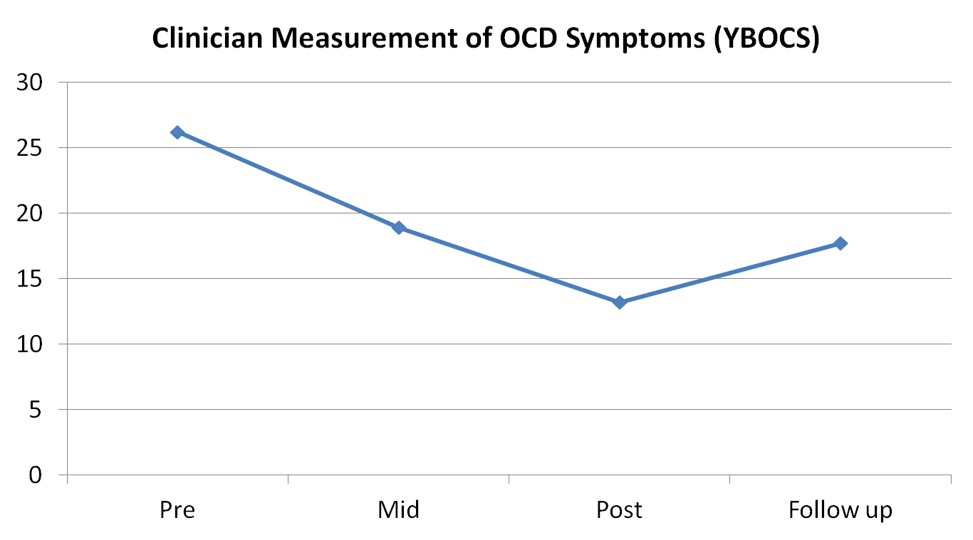
Treatment Outcome

Slide 32
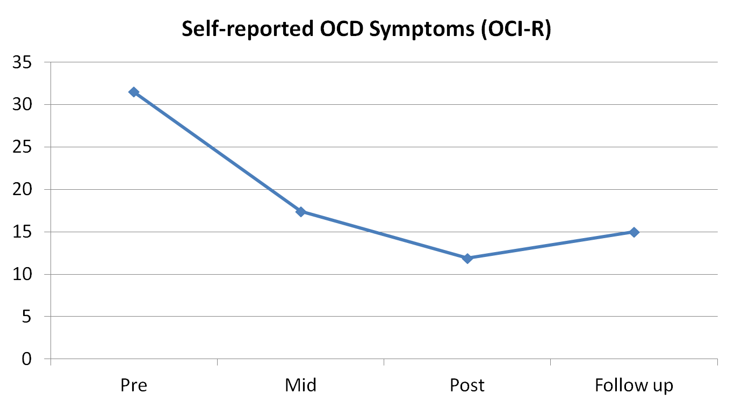
Treatment Outcome

Slide 33
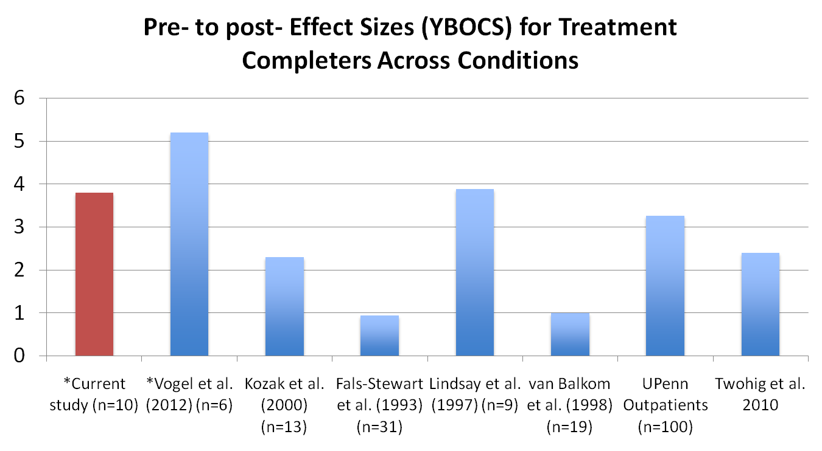
Effect Sizes
*Videoconference study

Slide 34
Can therapist time be minimized?

Slide 35
Study 3: Internet-based Self-Help for SAD with Remote Therapist Support

Slide 36
Web-Based Treatment Program
8 modules of ACT, adapted from our in-person SATP protocol (Herbert, Forman, & Dalrymple, 2009)
    Presented in an online presentations (30-45 minutes) per module per week
    Core concepts: mindfulness, willingness, defusion exercises, & social skills training
    Quizzes to assess understanding before progressing to the next module
    Supplemented by reading materials, exercises, and video clips
    Exposure Homework

Slide 37
Outline
Module | Description of Content
1 | Introduction; Overview of ACT; creative hopelessness; control as the problem
2 | Role and effects of safety behaviors and self-focused attention; gentle refocusing strategy; EXPOSURES , and fear hierarchy
3 | Willingness; social skills
4 | Values
5 | Cognitive defusion
6 | Mindfulness
7 | Conceptualized/observing self
8 | Post-treatment plan; relapse prevention

Slide 38
Components of Interface
Notes:
From the developer’s view – the ability to organize/build content

Slide 39
Screenshots

Slide 41
Tug of War
Notes:
(Introduction to Tug of War): The situation you are in is like being in a tug-of-war with a monster. It is big, ugly, and very strong. In between you and the monster is a pit, and so far as you can tell it is bottomless. If you lose this tug-of-war, you will fall into this pit and will be destroyed. So you pull and pull, but the harder you pull, the harder the monster pulls, and you edge closer and closer to the pit.

Slide 42
Drop the rope!
Notes:
Dropping the rope means the monster’s still there, but you’re no longer tied up in a struggle with it. Now you can live your life.
What it means to really “drop the rope?”
The monster (anxiety) will still be on the other side and may get louder and more annoying from time to time. If not engaging in the tug of war, individual is free to do whatever one needs/wants to do. Dropping the rope is a process, not a single act.
Dropping the rope frees you up to live your life! Note: not giving up. Distinguish between giving up and dropping the rope.
Not just an act that you do once, have to do it multiple times a day.

Slide 43

Recruitment
      Local and national advertisements
      Online SAD message boards
      Facebook Ads
      Referrals

Slide 44
Participants
13 Adults
69.2% female
Ages 23 – 57; mean age 33.2 (SD = 10.4)
69.2 % Caucasian, 69.2% employed full-time, 46.2% single, 53.8% had a college degree
Past tx history:
  9 of 13 had received tx in the past
    2 received group CBT (more than 15 years ago)
    2 SAD tx in context of other tx

Slide 45
Procedures
Initial contact for study information (n=67)
Phone screen (n=35)
Diagnostic Assessment (n=18)
Began treatment (n=13)
Completed treatment (n=13)

Slide 46
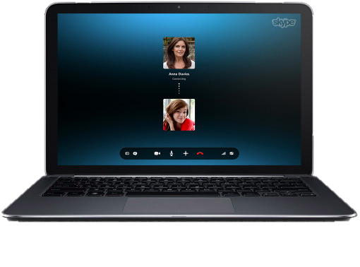
Therapist Support
From Skype.com

Slide 47
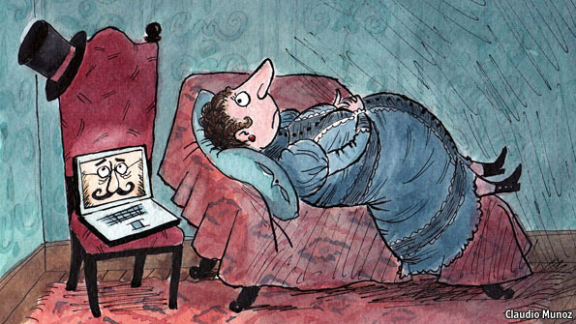
Skype Therapist Check-In
10-15 minutes (1x/week)
    provide support (e.g., empathic listening)
    clarify treatment concepts as needed
    trouble-shooting (e.g. exposure ideas)
    address technological questions
    discuss general issues with treatment
Video
  Serves a dual purpose
  Also a social exposure?
CBT

Slide 48
Results: Acceptability & Feasibility
Attrition was 0%!
92.3% completely or mostly satisfied with tx & therapist
92.3% found receiving the program as very or fairly easy
80.4% did not experience any technical difficulties during Skype therapist support
92.3% found therapist support helpful/very helpful
All said that they would recommend to a friend

Slide 49
Symptom Improvement
 | Pre Tx Mean | Post Tx Mean | t | p | Effect Size (d)
SPAI-SP | 139.53 | 89.07 | 5.61 | < .001 | 1.47
LSAS- Total | 78.85 | 51.85 | 5.33 | < .000 | 0.92
LSAS- Fear | 41.85 | 28.23 | 6.48 | < .001 | 0.90
LSAS-Avoid | 37.00 | 23.62 | 4.11 | = .001 | 0.88
CGI-Sev | 4.75 | 3.75 | 3.63 | = .004 | 0.99
Brief-FNE | 50.23 | 39.85 | 4.33 | = .001 | 1.17
BDI | 13.31 | 5.69 | 3.46 | = .005 | 1.11

Slide 50
Treatment Outcome – Self-report

Slide 51
Treatment Outcome – Self-report

Slide 52
Quality of Life, Psychosocial Functioning
 | Pre Tx Mean | Post Tx Mean | t | p | Effect Size (d)
QOLI | -0.79 | 1.07 | 2.67 | <.020 | 1.11
SDS-Total | 19.08 | 13.00 | 3.57 | =.004 | 0.95
SDS-Work | 6.23 | 4.62 | 2.72 | =.019 | 0.61
SDS- Social | 8.46 | 5.54 | 4.22 | =.001 | 1.14
SDS-Family | 4.38 | 2.85 | 2.01 | =.067 | 0.57

Slide 53
Process Measures
 | Pre Tx Mean | Post Tx Mean | t | p | Effect Size (d)
PHLMS-Acceptance | 26.00 | 27.92 | 1.67 | =.121 | 0.32
PHLMS – Awareness | 33.15 | 33.23 | .101 | =.921 | 0.03
AAQ- II | 31.92 | 25.62 | 2.82 | =.015 | 0.94
DDS | 20.54 | 30.92 | 5.70 | <.001 | 1.06

Slide 54
Baseline Predictors of Outcome
 | Change in LSAS | Change in SPAI | Change in Brief FNE
PHLMS-Acceptance | .26 (p = .39) | .41 (p = .16) | .52 (p = .07)
PHLMS-Awareness | .02 (p = .94) | -.15 (p = .62) | .05 (p = .87)
DDS | .71 (p = .01) | .67 (p = .01) | .37 (p = .21)
AAQ – II | .11 (p = .73) | -.49 (p = .09) | -.61 (p = .03)
RTQ | .07 (p = .82) | .07 (p = .83) | .28 (p = .35)

Slide 55
Program Adherence & Tx Outcome
 | LSAS | SPAI | Brief FNE
Content items (clicks) | .67 (p = .01) | .63 (p = .02) | .50 (p =.08)
Logins | .16 (p = .68) | .48 (p = .19) | .61 (p =.08)
Total time on Skype | -.16 (p = .61) | -.15 (p = .62) | -.36 (p =.23)

Slide 56
Participant Feedback - “What did you find most helpful about the treatment?”
“the learning of techniques and the metaphors”
“Defusion has been very beneficial for me, as have the exposures in overcoming certain fears I have. Thinking about my values has been a big motivation in overcoming them too. Also having the realization that I cannot stop negative thoughts but instead accept them and be willing to accept them is a big help in stopping "dirty anxiety" from occurring”
“Modules and working with a therapist to make myself accountable to another person.”
“Having an amazing therapist who I was comfortable sharing my social situations and emotions with.”
“I think being walked through each step by someone with patience and understanding was very helpful.”
“The visual metaphor examples and mindfulness exercises”
“The exposure exercises where helpful and due to the weekly check-ins you were held accountable for completing the exercises.”
“Convenience of the internet. The analogies and videos. The homework assignments and especially the therapist check in to guide me through some of the events I was going to stop avoiding. As well, pushing me to do them not too much and and not too little.”
“I found the Skype sessions to be the most beneficial.”
Notes:
Most

Slide 57
Participant Feedback – What did you find the least beneficial?
“the quizzes”
“mindfulness meditation”
“keeping daily logs”
“it was too rushed”
“I felt that I need more encouragement.”
“The speed, doing at least three weekly exposures was very intimidating and I felt very fatigued half of the time. Sometimes when I set a harder goal I would freeze and it really scared thinking about it over the next few days.

Slide 58
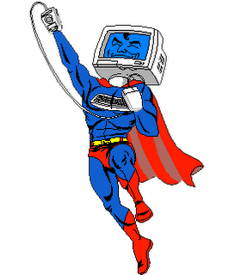
Advantages
Convenience
Cost effective
Flexibility
Easy access to home environment
Easy to involve family
Effective

Slide 59
Challenges
Monitoring subtle avoidance behaviors
Technological problems
Limited camera view
Reduced commitment (at times)

Slide 60

Key Clinical Recommendations
Fully informed consent
Anticipate technical difficulties
  Provide tutorial in use of videoconference platform, & tech support
  Encourage patients to verbalize technical difficulties and feelings of discomfort
Model exposures as you would in face-to-face treatment
Minimize distractions
Use non-wireless Internet connection
Position webcam strategically
Conduct exposures in the “real-world” via laptops or mobile devices

Slide 61
Conclusions
VC tx, as well as Internet-Self Help Program supplemented by VC, are acceptable, feasible, & effective
Internet Interventions based on ACT principles provide another distinct approach to treating individuals with SAD
Could be used to overcome some of the barriers associated with the dissemination of evidence-based treatments
  those residing in rural (or other) areas to increase access
  those who may be hesitant to seek in-person treatment

Slide 62
Some Future Directions
Future Studies
  VC vs. Face-to-face RTC
  Web-based with vs. without therapist support
  Web-based CT vs. web-based ACT
  Incorporation of mobile devices
  Stepped care approach
  Dismantling studies
  Mediation and moderation
  Other
  Ways to increase adherence to exposure assignments
  ACT-specific principles & techniques
Regulatory issues
Alternative platforms (e.g., VSee)

